Slide 1
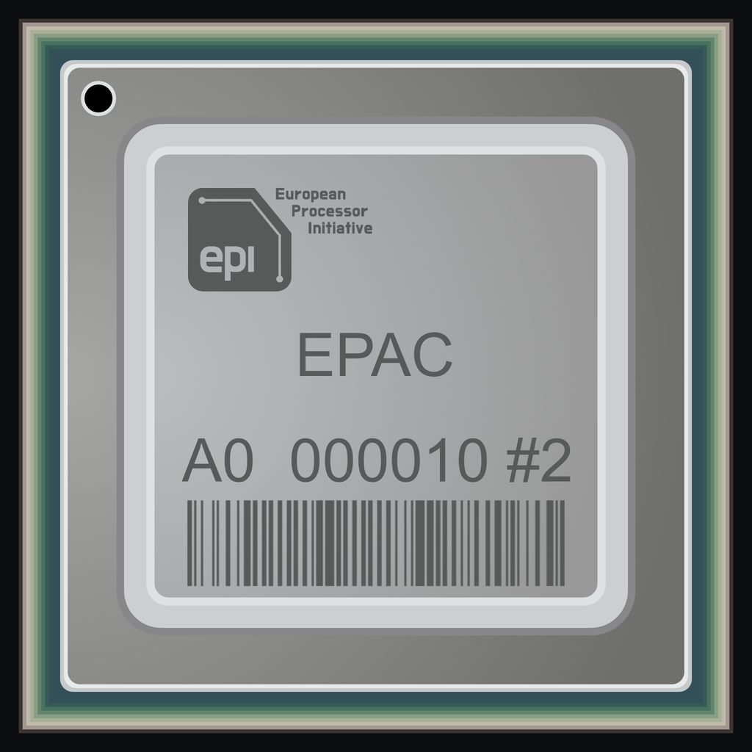
Optimizing Sparse matrix-vector multiplication on the EPAC architecture
ASHPC25,
Rimske Toplice, Slovenia, 19 – 22 May, 2025
Notes:
Hello, and thank you for this opportunity. We are excited to present our work on optimizing Sparse Matrix-Vector Multiplication, or SpMV, on the EPAC architecture – a major milestone in Europe's pursuit of processor independence.”

Slide 2
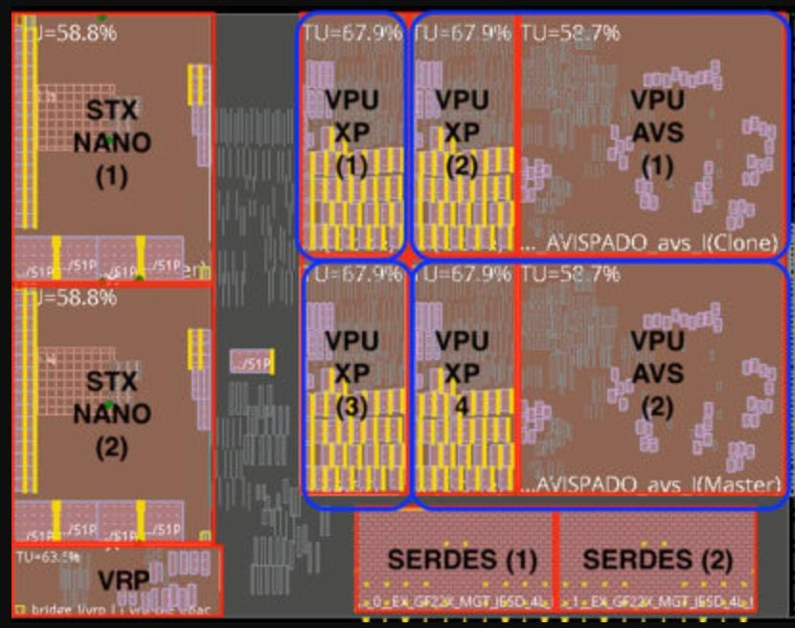
EPAC – European processor accelerator core
Notes:
Our work aligns with the European Processor Initiative, which aims to develop high-performance, energy-efficient processors with fully European technology. At the core of our study is the Vitruvius vector processor built on the RISC-V Vector extension for which we can see the schematic on the screen.”

Slide 3
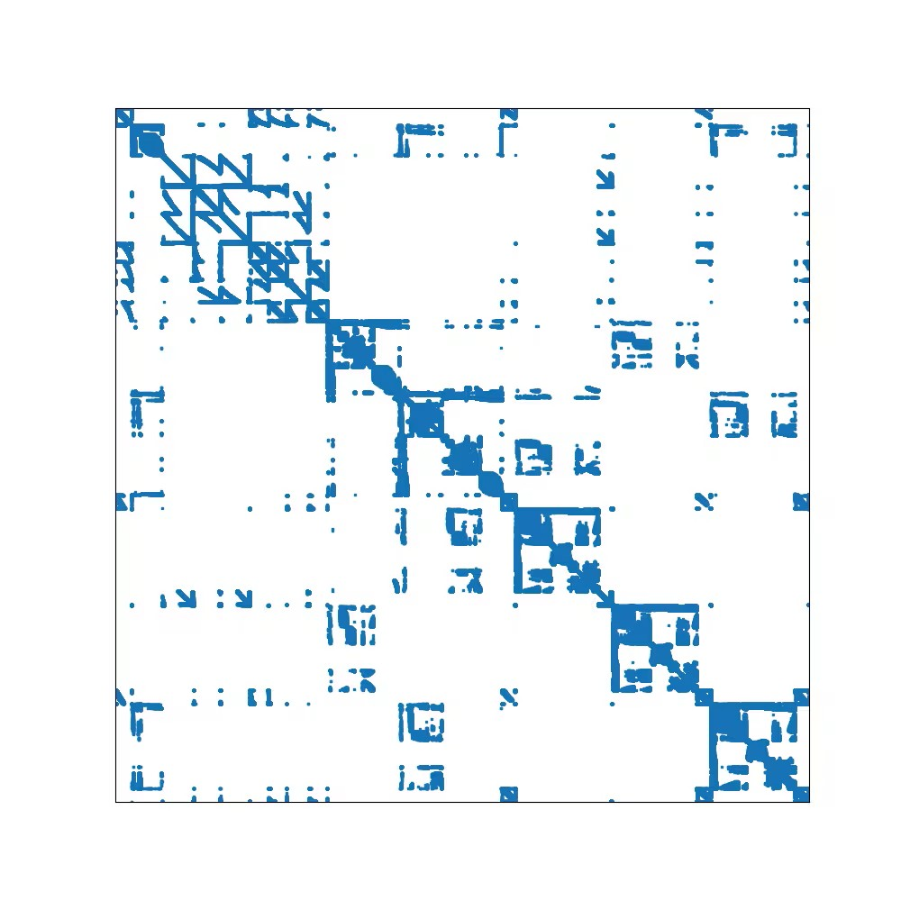
Sparse matrix
Matrices with the majority of elements zero
Compact representation
Storing in a format which avoids storing zeros
Irregularity is a drawback in parallel implementations
Different formats optimize storage or computation
Notes:
We are interested in sparse matrices as they are still mystery in the world of high performnance computing. The sparse matrices are just regular matrices but with majority zero elements, therefore we came up with different representation, which avoid storing zero elements. However, by focusing on non-zero elements we pay a price as we open doors to the irregular access, which breaks principles of caches

Slide 4
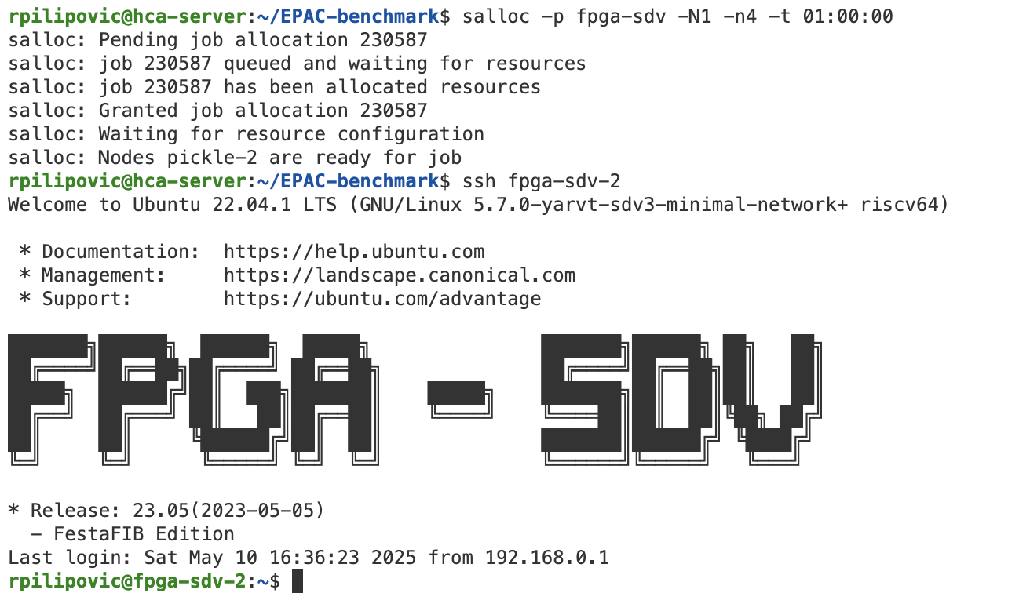
Experimental setup
Experiments run on FPGA Software Development Vehicles (FPGA – SDV)
Implement Vitrivius architecture on FPGA fabric
Located at the HCA server at the Barcelona supercomputing centre
Notes:
Our experiments were run on FPGA Software Development Vehicles that emulate EPAC processors, hosted at the Barcelona Supercomputing Center.”

Slide 5
Compressed Sparse Row (CSR) format
Data: Compressed non-zero elements
Columns: Index of columns
2
3
4
7
8
9
5
6
2
9
7
1
1
3
9
0
4
6
8
9
7
7
0
9
4
2
5
8
0
4
5
9
Input vector
x0
x1
x2
x3
x4
x5
x6
x7
Notes:
One of the most fundemental format still represents CSR -> Compressed Sparse Row Format in which we eliminate non zero elements at each row and present them in representation. To know the original location of elements, we store non-zero elements as well as their column indices.

Slide 6
Sparse matrix-vector multiplication (SpMV) with CSR Vector length = 8
Columns (VREG)
Input vector in memory
2
3
4
7
8
9
5
6
Memory Gather
x0
x1
x2
x3
x4
x5
x6
x7
x2
x3
x4
x7
x8
x9
x5
x6
VMUL
Data (VREG)
Masked reduction
Result
First row
Second row
Notes:
How do we execute SpMV. The idea is simple, by relying on column indices we employ memory gather operation to get to the elements of input vector. Then we employ vector multiplicitatio to calculate product between non zero elements of matrix and vector. Thre we perform masked reduction, as some parts of vectors may belong to a different row.

Slide 7
SpMV with CSR, Vector length = 8
Columns (VREG)
Input vector in memory
2
9
7
1
1
3
9
6
Memory Scatter/Gather
0
x0
x1
x2
x3
x4
x5
x6
x7
x2
x9
x7
x1
x1
x3
x9
x0
VMUL
Data (VREG)
Masked reduction
Result
Notes:
The we continue in a simmilar manner with next batch of data

Slide 8
SpMV with CSR, Vector length = 8
Columns (VREG)
Input vector in memory
4
6
8
9
7
7
0
6
Memory Scatter/Gather
9
x0
x1
x2
x3
x4
x5
x6
x7
x4
x6
x8
x9
x7
x7
x0
x9
VMUL
Data (VREG)
Masked reduction
Result
Notes:
and producing one element of output vector

Slide 9
SpMV with CSR, Vector length = 8
Columns (VREG)
Input vector in memory
4
2
5
8
0
4
5
6
Memory Scatter/Gather
9
x0
x1
x2
x3
x4
x5
x6
x7
x4
x2
x5
x8
x0
x4
x5
x9
VMUL
Data (VREG)
Masked reduction
Result
Notes:
at time.

Slide 10
SpMV with CSR without Gather/Scatter operation
Input vector in VREG
Columns (VREG)
Input vector in memory
Vector permutation
2
3
4
7
8
9
5
6
Memory Gather
x0
x1
x2
x3
x4
x5
x6
x7
x2
x3
x4
x7
x8
x9
x5
x6
VMUL
Data (VREG)
Masked reduction
Result
First row
Second row
Notes:
This is however one approach. On the other side, we explore also vector permuatiation function that involve communication between lanes in vector processor. The idea is simple, we load the vector without gather operation, thus relieving it from irregular access in memory and let the VPU to reshuffle elements.

Slide 11
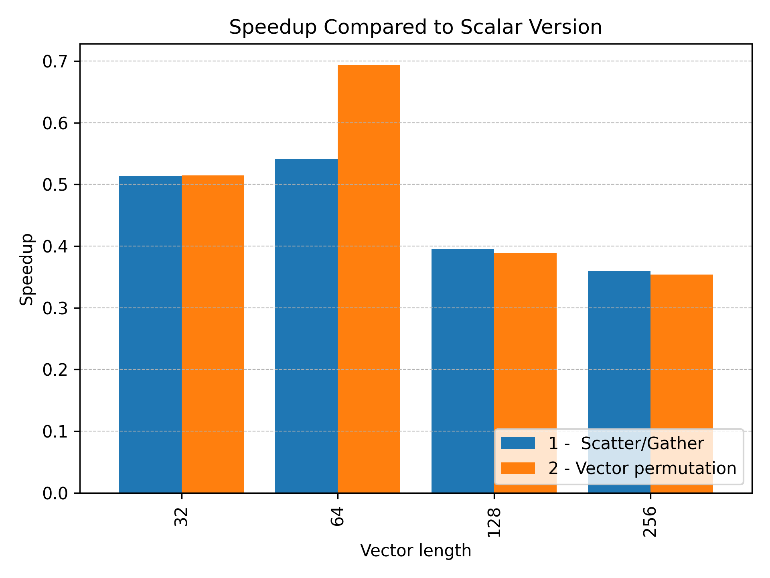
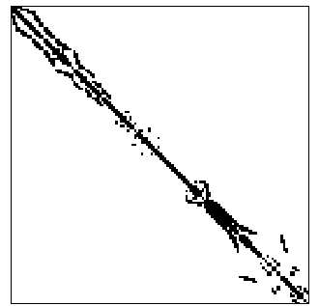
Results
DWT_512.mtx
Notes:
We experimented with couple of matrix. The first is DWT_512 which is presented on the left (the black part are non zero elements). As we can see the speed up is smaller than 1, meaning that vectorized version underperforms, both of them.

Slide 12
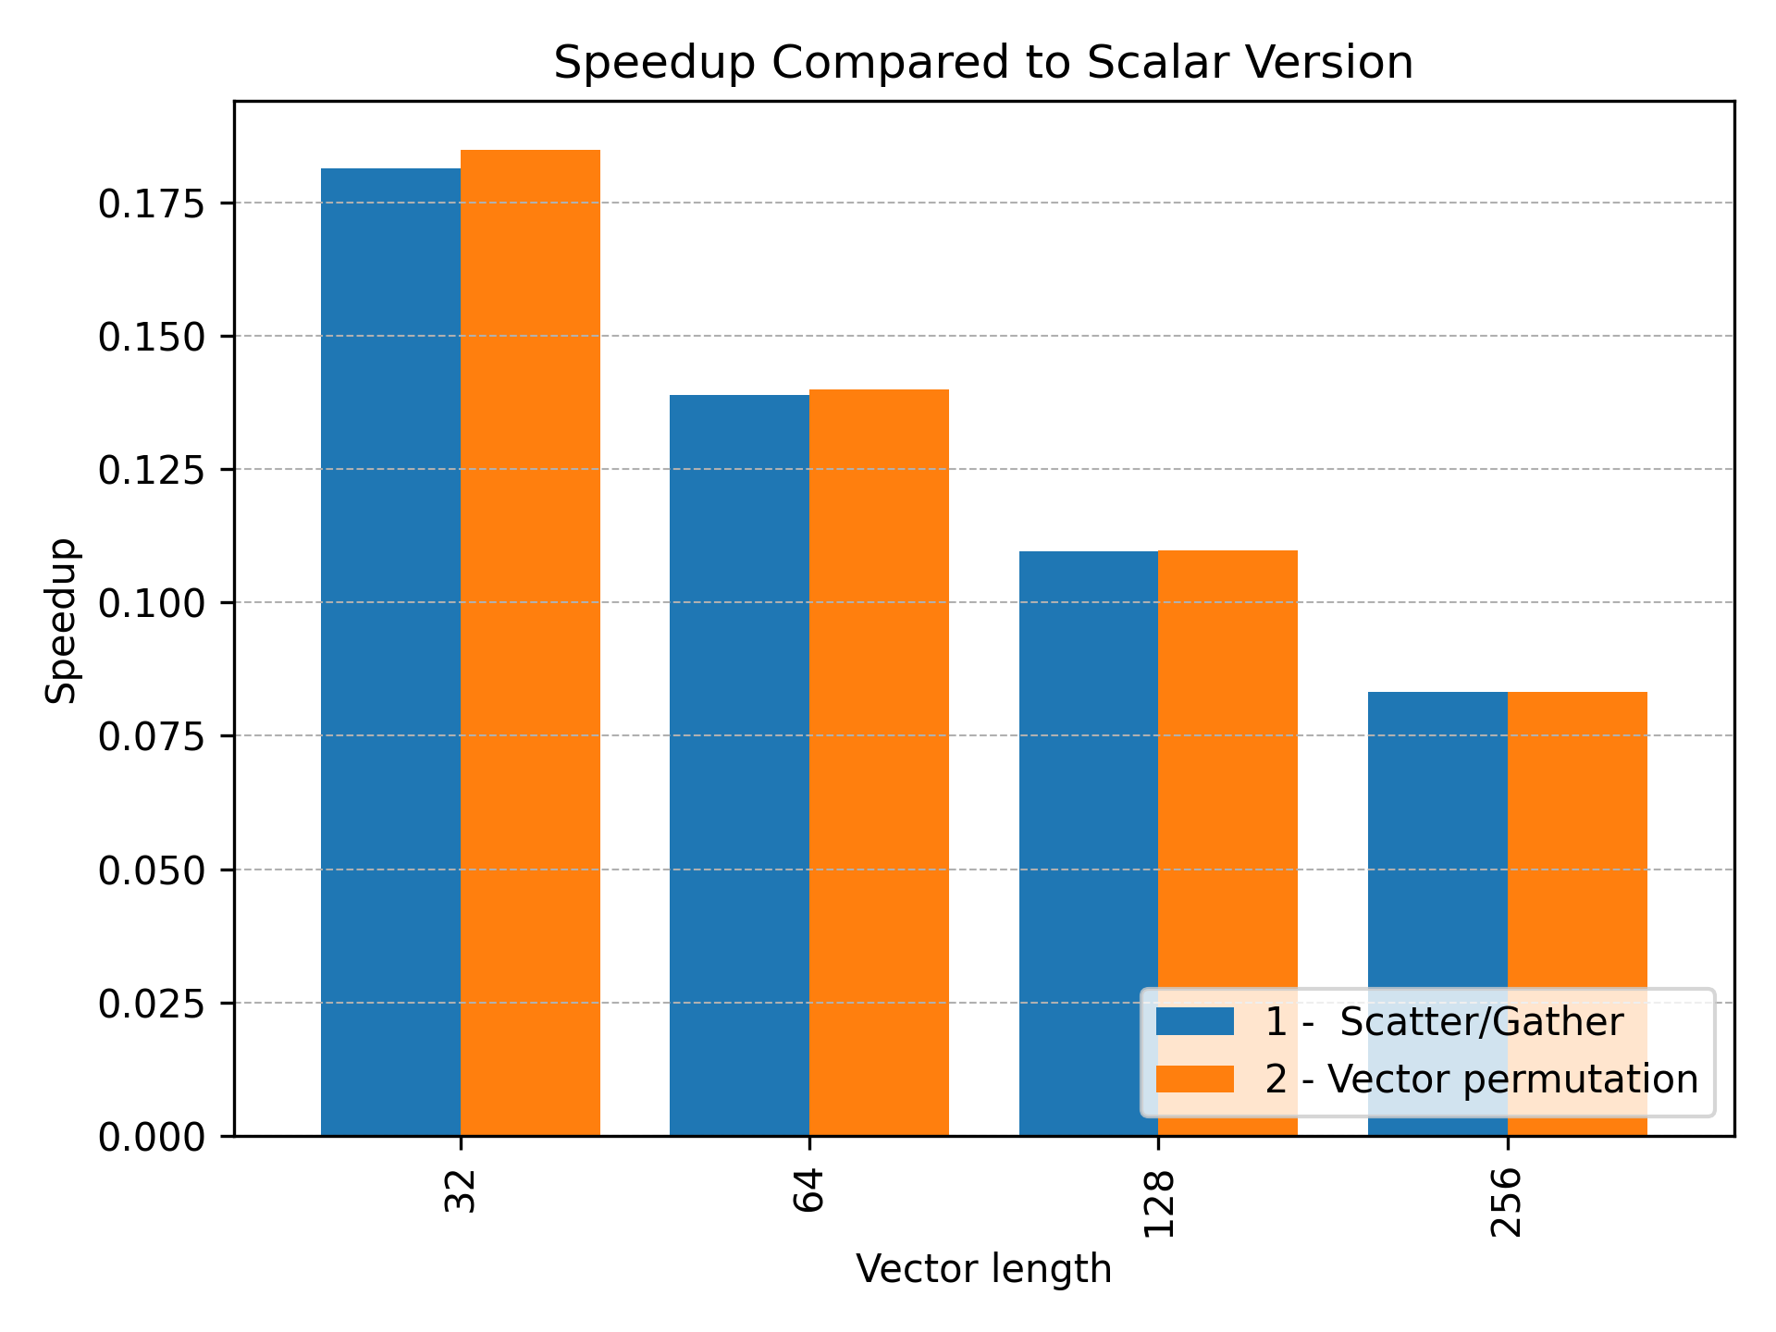
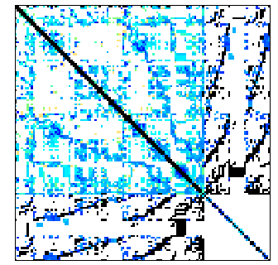
Results
scircuit.mtx
Notes:
The simmilar thing for scircuit matrix

Slide 13
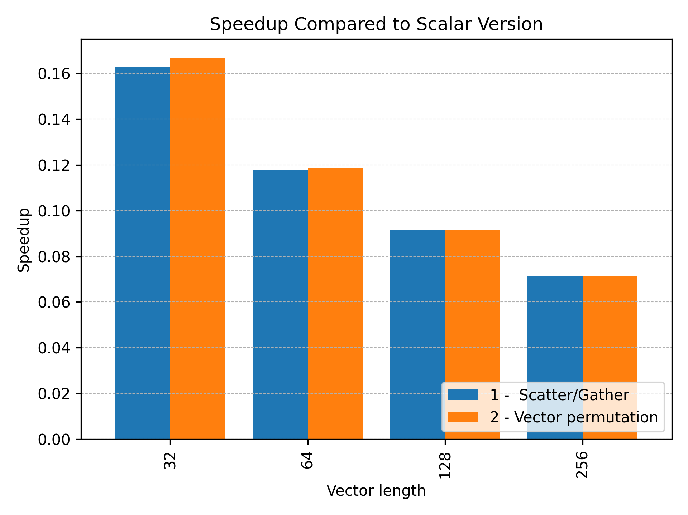
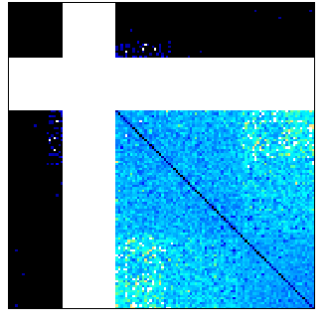
Results
cop_20kA.mtx
Notes:
and for cop_20KA matrix. We attribute this to the masked reduction as the reduction operation in VPU requires the traffice on the NOC that connects vector lanes.

Slide 14
ELLPACK (ELL) format
Data: Compressed non-zero elements
0
0
0
0
0
0
Columns: Index of columns
2
3
4
7
8
9
5
6
2
9
7
1
1
3
9
0
4
6
0
9
7
0
0
9
4
2
5
8
0
0
0
0
Input vector
x0
x1
x2
x3
x4
x5
x6
x7
Notes:
Now more advanced format and more suitable for parallel architectures is ELL, which retains some zero elements however is more compute friendly.

Slide 15
SpMV with ELL, Vector length = 8
Columns (VREG)
Input vector in memory
2
3
4
7
8
9
5
6
Memory Scatter/Gather
6
x0
x1
x2
x3
x4
x5
x6
x7
x2
x3
x4
x7
x8
x9
x5
x6
*
VMAC
Data (VREG)
+
0
0
0
0
0
0
0
0
Accumulator
Result
Notes:
The nature of ELL format, let us to represetn SpMV as iterative Multiply and ADD, which alleviates the need for vector reduction

Slide 16
SpMV with ELL, Vector length = 8
Columns (VREG)
Input vector in memory
2
9
7
1
1
3
9
6
Memory Scatter/Gather
0
x0
x1
x2
x3
x4
x5
x6
x7
x2
x9
x7
x1
x1
x3
x9
x9
*
VMAC
Data (VREG)
+
Accumulator
Result

Slide 17
SpMV with ELL, Vector length = 8
Columns (VREG)
Input vector in memory
4
2
5
9
7
0
0
6
Memory Scatter/Gather
9
x0
x1
x2
x3
x4
x5
x6
x7
x4
x6
x0
x9
x7
x0
x0
x9
*
VMAC
0
0
Data (VREG)
+
Accumulator
Result

Slide 18
SpMV with ELL, Vector length = 8
Columns (VREG)
Input vector in memory
4
2
5
9
0
0
0
6
Memory Scatter/Gather
0
x0
x1
x2
x3
x4
x5
x6
x7
x4
x6
x0
x9
x0
x0
x0
x0
*
VMAC
0
0
0
0
Data (VREG)
+
Accumulator
Result

Slide 19
SpMV with ELL, Vector length = 8
Columns (VREG)
Input vector in memory
4
2
5
9
0
0
0
6
Memory Scatter/Gather
0
x0
x1
x2
x3
x4
x5
x6
x7
x4
x6
x0
x9
x0
x0
x0
x0
*
VMAC
0
0
0
0
Data (VREG)
+
Accumulator
Result
Notes:
We also experiment with the vector permutation as described previous.

Slide 20
SpMV with ELL without Gather, Vector length = 8
Input vector in memory
Columns (VREG)
Input vector in VREG
Vector permutation
2
3
4
7
8
9
5
6
Memory Scatter/Gather
6
x0
x1
x2
x3
x4
x5
x6
x7
x2
x3
x4
x7
x8
x9
x5
x6
*
VMAC
Data (VREG)
+
0
0
0
0
0
0
0
0
Accumulator
Result
And so on!

Slide 21
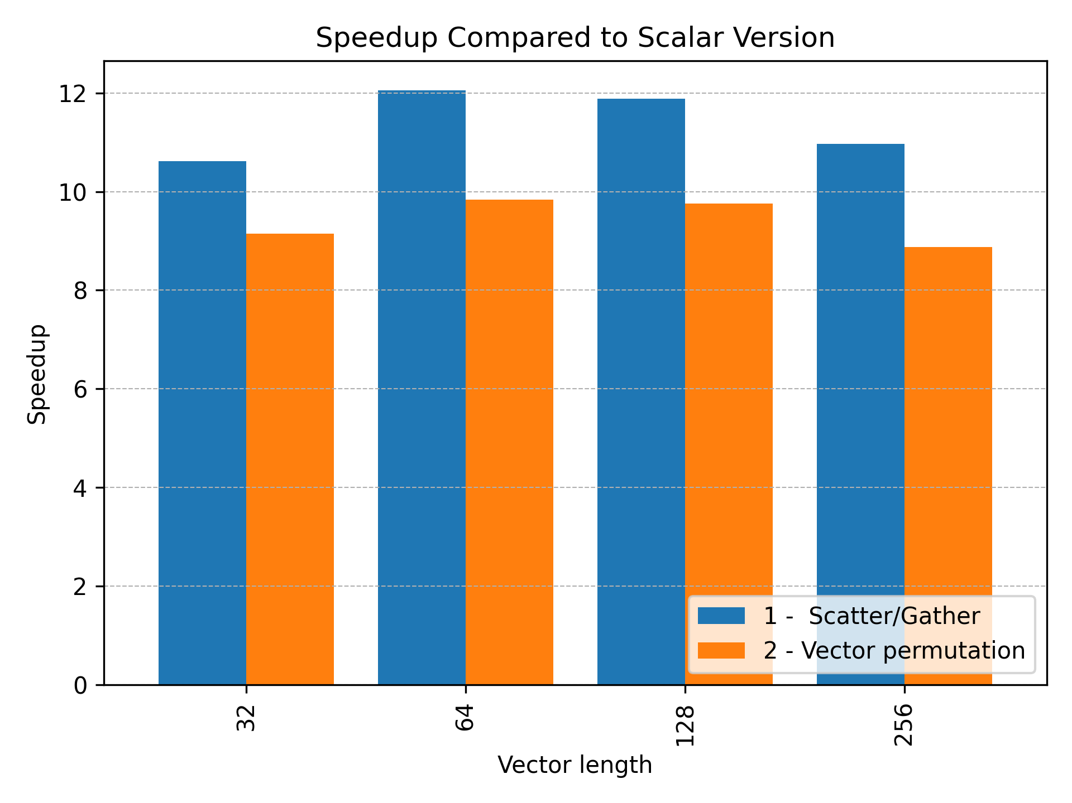
Results
DWT_512.mtx
Notes:
The results are now quite better, over 8x impovements in speed over scalar version

Slide 22
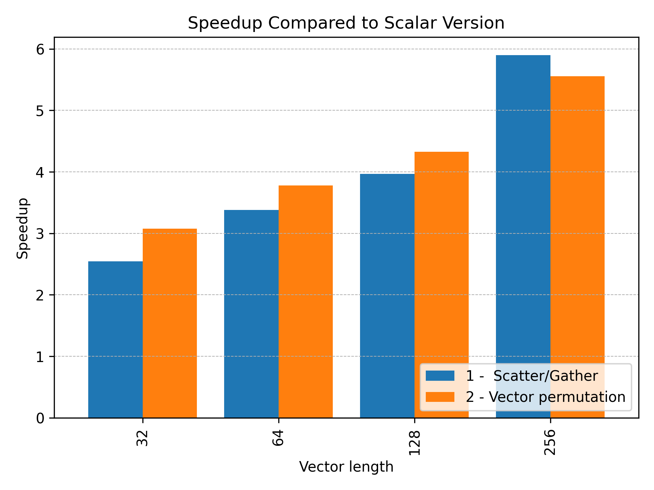
Results
scircuit.mtx
Notes:
We even see now how for different matrices the vector permuation can give better performance.

Slide 23
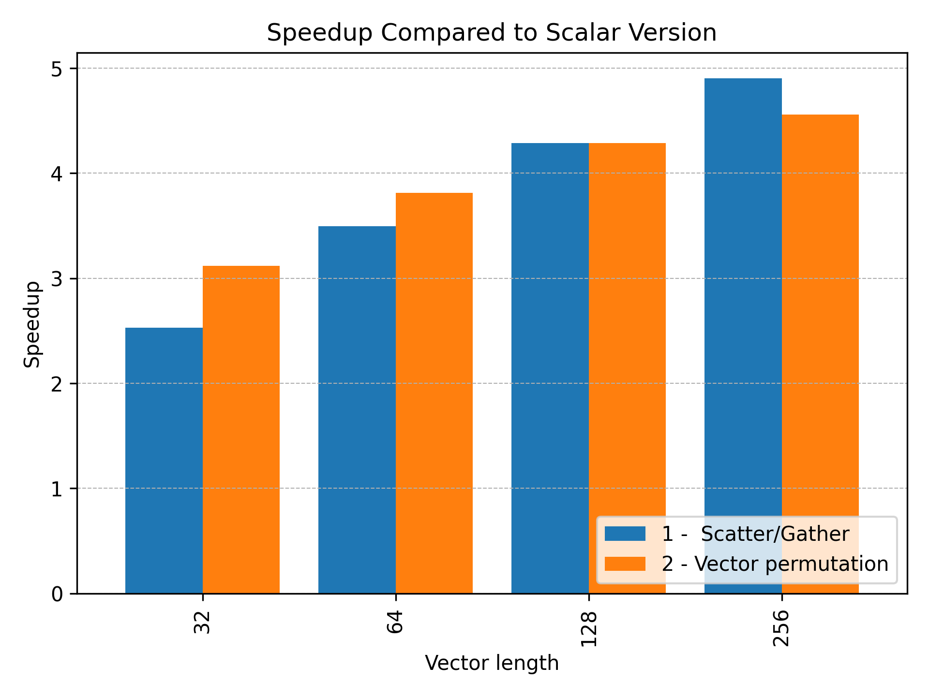
Results
cop_20kA.mtx
Notes:
We attribute this behaviou r

Slide 24
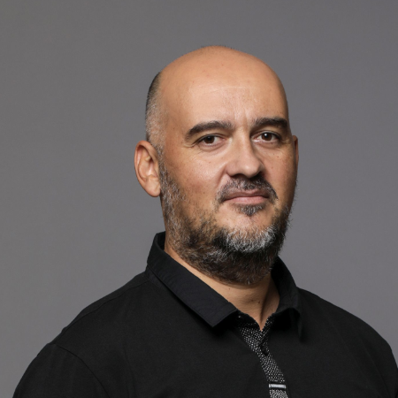
Acknowledgments
joint collaboration with the University of Zagreb, Faculty of Electrical Engineering and Computing
European Processor Initiative project and Barcelona Supercomputing center
prof. dr. Mario Kovač
prof. dr. Josip Knezović

Slide 25
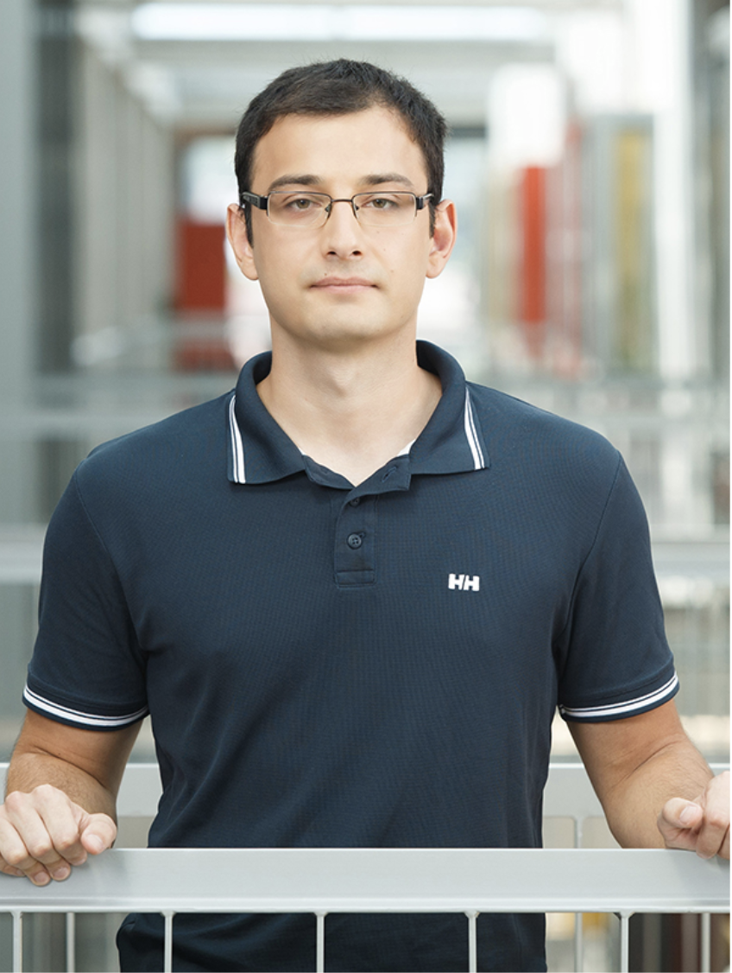
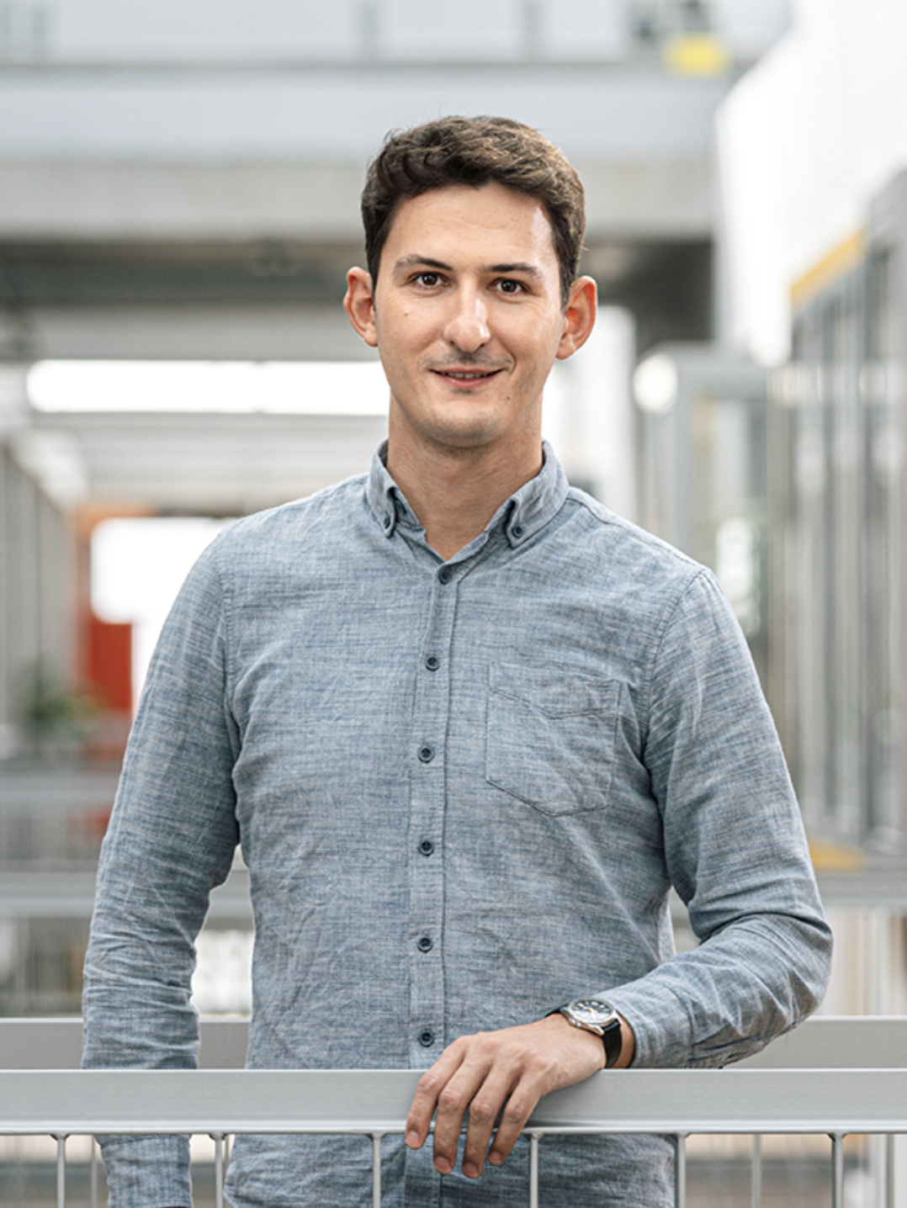
Open for questions!
Dr. Davor Sluga
Faculty of Computer and Information Science,
University of Ljubljana,
mail: davor.sluga@fri.uni-lj.si
Dr. Ratko Pilipović
Faculty of Computer and Information Science,
University of Ljubljana,
mail: ratko.pilipovic@fri.uni-lj.si

