Slide 1
Cell simulation: the ultimate way to develop better drugs
Austrian-Slovenian HPC Meeting 2025 – ASHPC25
Presenter: Dr. Draško Tomić, Institut Ruđer Bošković
email: drasko@irb.hr

Slide 2
Why Whole-Cell Simulation Matters
WCS: A computational approach that aims to simulate an entire living cell with atomic or molecular resolution.
Why do we need WCS?
To understand complex biological systems that go beyond simulations of individual proteins.
To revolutionize drug discovery, especially for cancer therapies.

Slide 3
Current challenges in cancer treatment
Drug resistance and suboptimal drug combinations.
High failure rates in clinical trials.
Need for a predictive, precise approach.

Slide 4
A Brief History of Whole-Cell Simulations
Early Computational Biology (2000s-2010s):
MD tools (NAMD, AMBER, GROMACS) focused mainly on single proteins and molecular interactions.
Coarse-grained approaches helped model larger biomolecular assemblies.

Slide 5
Advancements in the 2010s-2020s:
First whole-cell simulations at low resolution (Mycoplasma).
Stanford University, 2012, BioX2 cluster
AI-enhanced molecular simulations and multi-scale modeling (protein folding).
DeepMind, 2020, AlphaFold 2
HPC-powered breakthroughs: Simulation of the viral envelope of Sars-Cov-2 (~305 million atoms)
Oak Ridge National Laboratory, 2020, NAMD, Summit supercomputer

Slide 6
The State of the Art in WCS
Current capabilities:
Molecular simulations of subsystems (ribosomes, DNA repair, viral entry mechanisms).
Multiscale models combining MD + AI + network-based approaches.
Supercomputers and GPU accelerators pushing limits (~100 million atoms simulated).

Slide 7
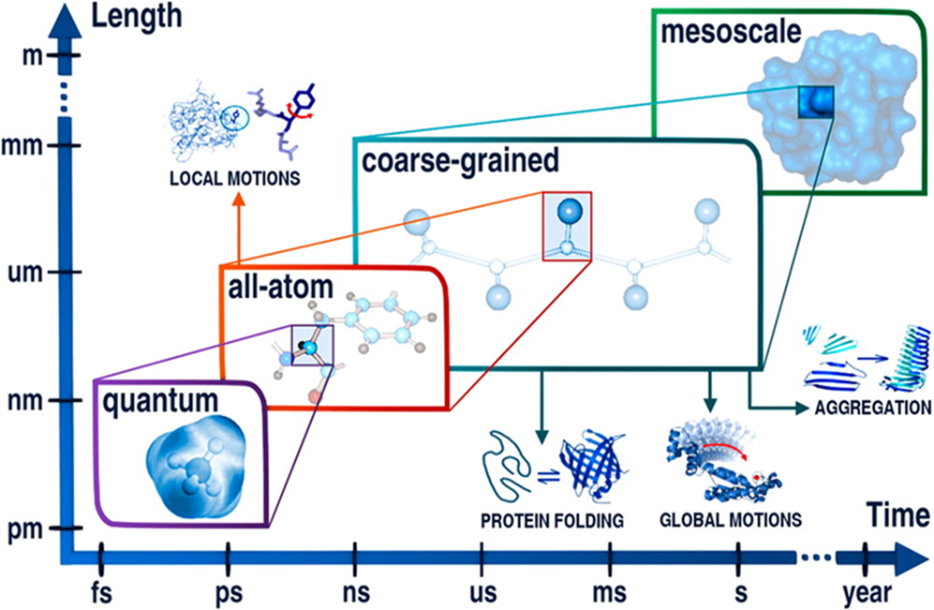
Limitations
WCS remains computationally intensive and requires extreme parallelism.
Problem of time scaling: The simulation of a complete cell over biologically relevant time scales (>ms) is not feasible today.

Slide 8
Our Vision
From VINI to real-time WCS for cancer drug discovery.
VINI today:
Uses KEGG pathways and novel algorithms to "simulate" cancer at the cellular level.
Predicts the efficacy of drugs and their combinations based on network dynamics.
Already helps identify better combined therapies than trial-and-error clinical approaches.

Slide 9
The Future: WCS Becomes as Fast as Virtual Screening
Next step: transition from pathway-based modeling to WCS at the molecular level.
What if we could model every atom, every molecule and every interaction inside a cancer cell -- live?
AI-driven force fields would predict interactions in real time (to bridge the gap between the accuracy of ab initio methods and the efficiency of classical FFs).
HPC + Quantum Computing would make cell-wide simulations possible.
We could test thousands of drug combinations instantly, to find the ultimate therapy.

Slide 10
How to Get There? (Roadmap for WCS)
Short term (~2030s): Hybrid AI-MD simulations improve speed & accuracy.
Mid-term (~2040s): AI-hybrid QC accelerates WCS, but MD limits still remain.
Long term (~2050s): Fully quantum-powered WCS enables real-time whole-cell drug testing.

Slide 11
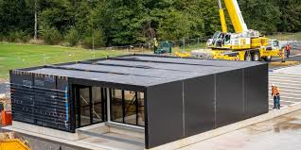
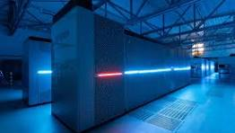
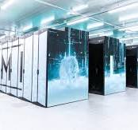
Results on Vega, LUMI, JURECA, and JEDI
DNA methyltransferase enzime 1 (DNMT1) in complex with DNA
~ 500,000 atoms
Software: NAMD
2023
2023-2024
2024
2025
2026

Slide 12
Vega
NAMD 2.14 on CPUs
Results:
Prepared topology and parameter files
Prepared input simulation files
Test simulations passed
LUMI resources estimated

Slide 13
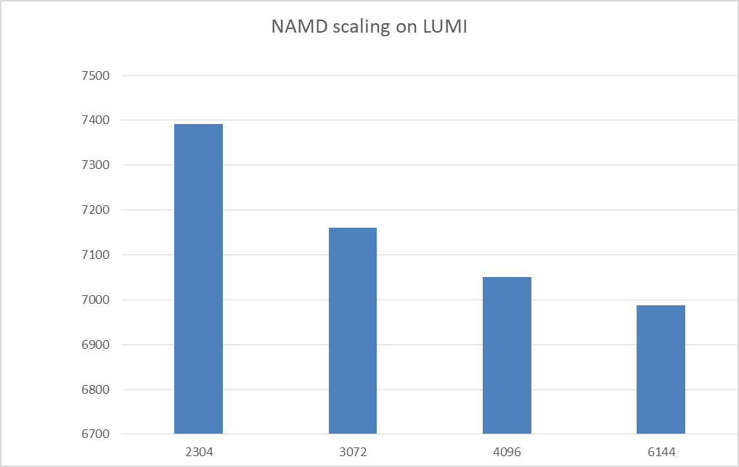
LUMI
NAMD 2.14 on CPUs
Results:
Scaling up to 6144 CPUs observed.
The bandwidth of the LUMI interconnect and the small size of the molecular structure limited further scaling.

Slide 14
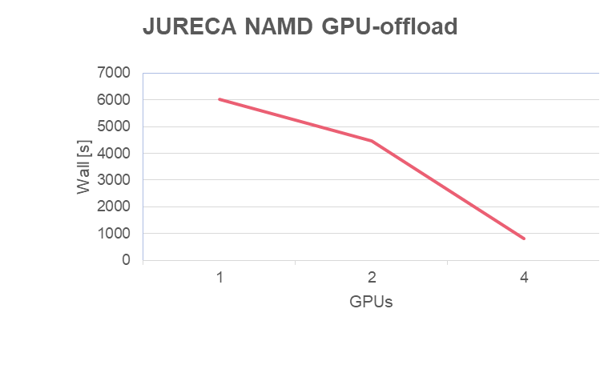
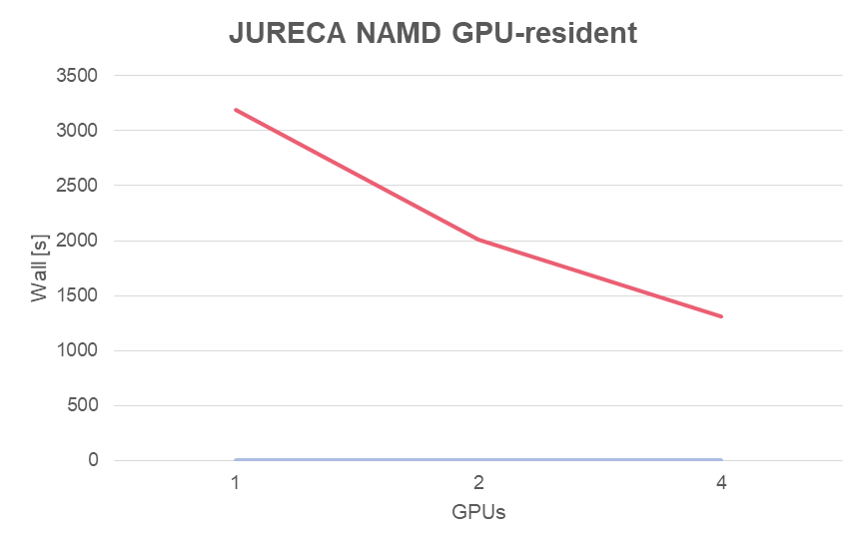
JURECA - Juelich Forschum Center
NAMD 3.01 on GPUs
Results:
Compared NAMD (GPU-offload & GPU-resident) modes.
Prepared simulation scripts for JEDI.

Slide 15
Call to Action
HPC + AI + QC: The Next frontier in WCS
Opportunities for collaboration in high-performance simulation frameworks.
Thank you for your time!
Questions?

