Slide 1


SLAIF
SLOVENIAN ARTIFICIAL INTELLIGENCE FACTORY
Slovenska tovarna umetne intelligence
Sašo Džeroski, Dragi Kocev
Andrej Filipčič, Jan Jona Javoršek

Slide 2
ARTIFICIAL INTELLIGENCE FACTORIES: WHAT ARE THEY?
AI factories have two main components
AI-optimized supercomputer (AI-HPC)
AI-factory activities and services

Slide 3
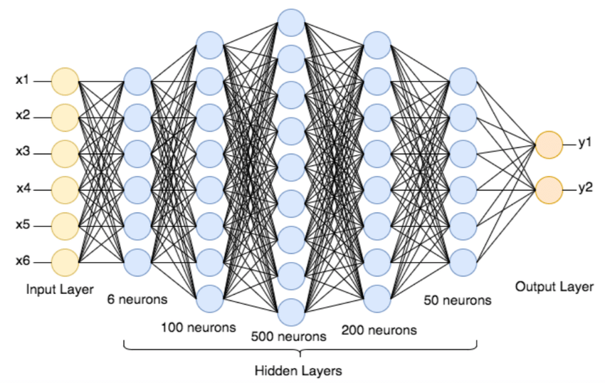
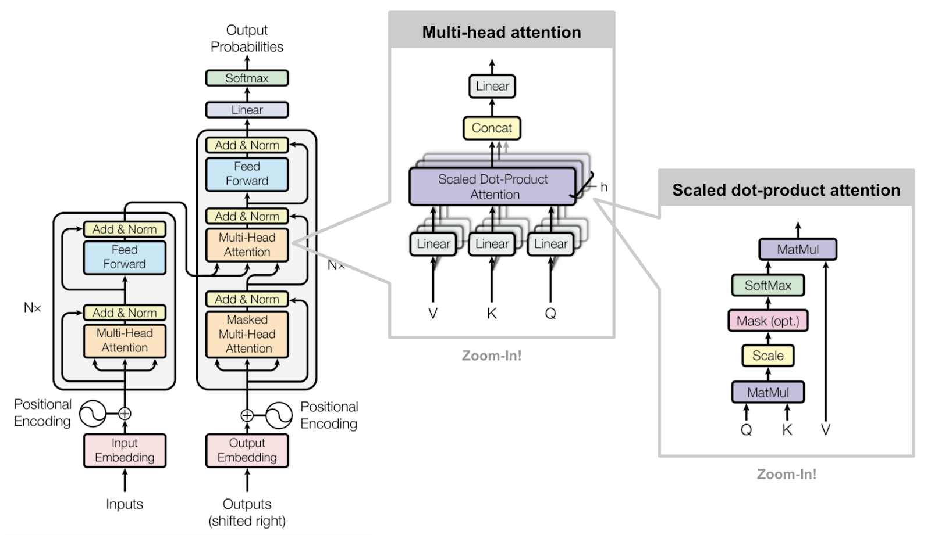
ARTIFICIAL INTELLIGENCE:
NN HISTORY IN A NUTSHELL
A perceptron/ Artif. Neuron A shallow NN Learning weights in NNs (back-prop)
A deep NN (many layers, many parameters) A transformer NN architecture (even more layers and parameters)

Slide 4
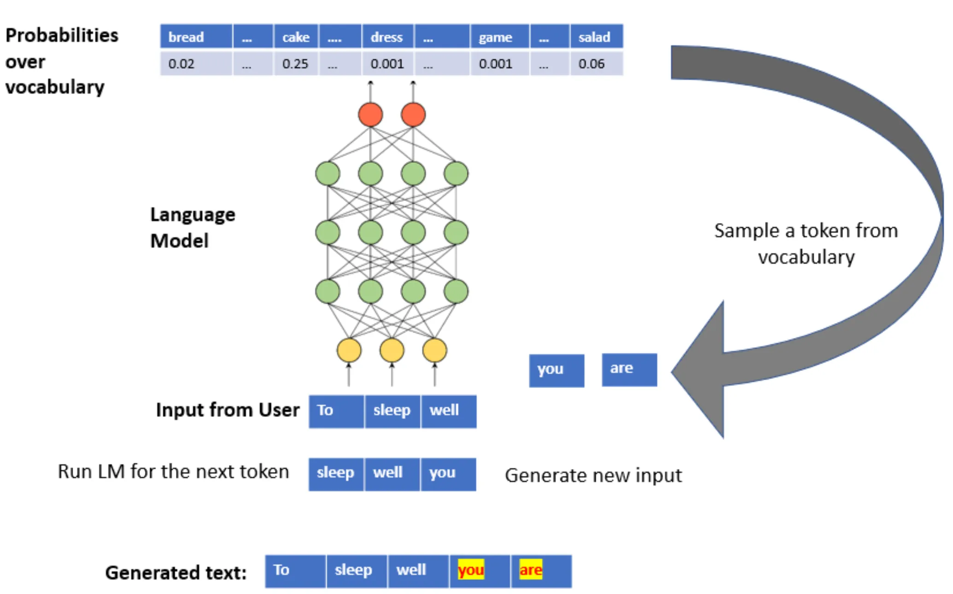
GENERATIVE ARTIFICIAL INTELLIGENCE:
LARGE LANGUAGE MODELS
LARGE LANGUAGE MODELS (LLMs) are huge deep NNs with billions of parameters
They are trained on huge amounts of text
They predict the next word after given partial text and can be used to generate new text

Slide 5
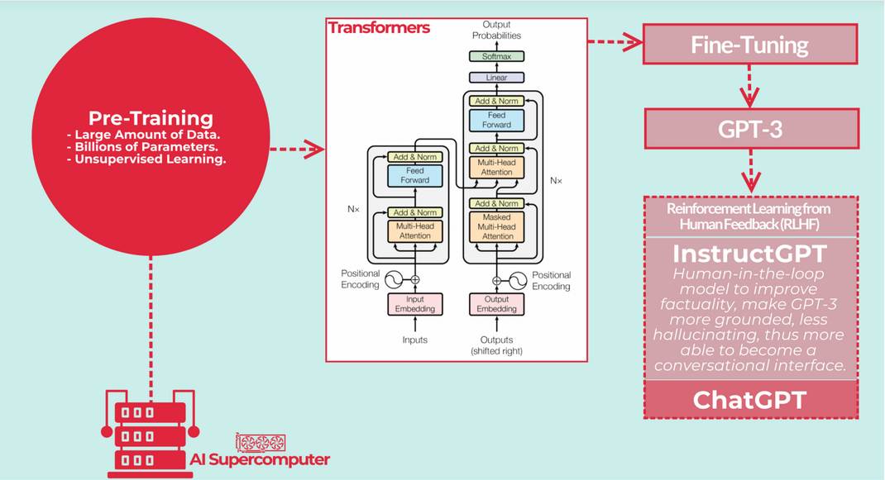
ARTIFICIAL INTELLIGENCE TODAY: LLMs and ChatBots
ChatGPT = GPT + Conversational Interface

Slide 6
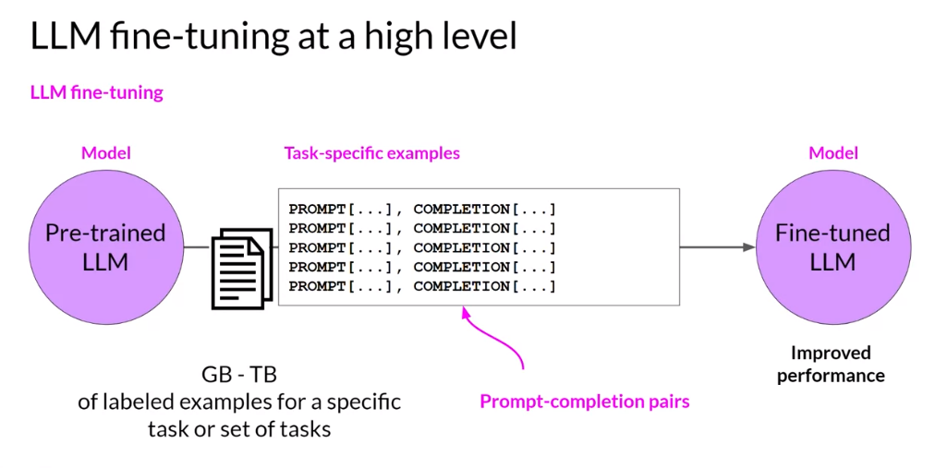
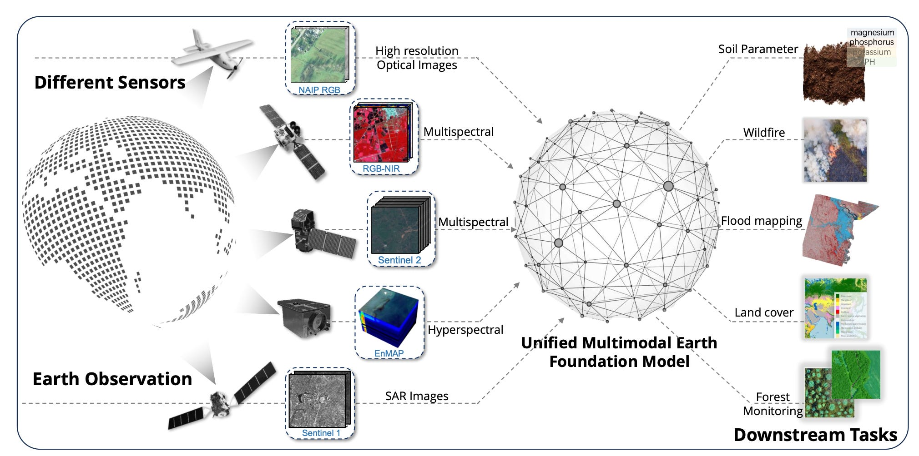
WHY DO WE NEED
ARTIFICIAL INTELLIGENCE FACTORIES?
Mostly to pre-train and fine-tune LLMs and other generative AI models, incl. multi-modal foundation models (working on, e.g., both text and images)
Foundation models (FMs) are large models, generated by applying ML (deep learning) to a broad collection of data at scale. Can be adapted for use in a wide range of downstream tasks. LLMs are a prime example of FMs.
Multi-modal FMs (e.g., with
different RSI modalities)

Slide 7
SLAIF: AI AS INFRASTRUCTURE
FOR SOCIETY AS A WHOLE
The Slovenian AI factory will support the growth of the Slovenian & regional AI ecosystem
At JSI, we view AI as infrastructure for science for quite a while
SLAIF will support industry, public sector, science: AI infrastructure for the whole society
AI HPC Consortium: IZUM (Hosting Entity), JSI, ARNES
AI Factory Consortium: JSI (technical coordinator), UniLj, UniMb, FIS NM, UniNG, UniPr,
IZUM (administrative coordinator), ARNES, GZS, TPLj

Slide 8




THE AIF CONSORTIUM
The SLAIF consortium brings together Slovenia's leading institutions in research & education, HPC infrastructure, and industry support, creating a powerful alliance to implement the AI Factory. In collaboration with IT4LIA and AI:AT.
Research Powerhouses
Infrastructure Specialists
Jožef Stefan Institute (JSI) leads the consortium with strong expertise in HPC, AI, and technology transfer. University of Ljubljana (UL) and University of Maribor (UM) additionally contribute educational capabilities.
IZUM serves as the EuroHPC JU Hosting Entity for HPC Vega, while ARNES provides advanced internet services and coordinates SLING. Faculty of Information Studies (FIS) has experience in both AI and HPC infrastructure.
Industry Connectors
Regional Expertise
Technology Park Ljubljana (TPLJ) supports SMEs and startups in adopting advanced technologies, while the Chamber of Commerce and Industry of Slovenia (GZS) represents over 5,200 member companies.
University of Nova Gorica (UNG) and University of Primorska (UP) provide additional research capabilities and international connections, strengthening the consortium's regional coverage. Others through SLING.

Slide 9
AI FACTORY WORK PACKAGES
The SLAIF implementation is organized into seven interconnected work packages, each with specific objectives and responsibilities to comprehensively develop the AI Factory.
WP1: Project Management (JSI)
WP2: Workflow and Data Orchestration Infrastructure (JSI)
Ensures smooth coordination across consortium partners and stakeholders, establishes inclusive policies for service access, and maintains quality assurance to meet project milestones effectively.
Develops robust infrastructure integrating HPC and cloud resources for scalable execution of AI workflows and establishes a national data lake enabling automated data exchange.
WP3: Core AI Platform (UL)
WP4: User-Centric AI Services (UM)
Delivers core AI platform workflows as generic horizontal services, maintains a semantic catalogue of AI components, and supports development and deployment of AI workflows.
Focuses on making HPC/AI clusters more user-friendly for first-time users, providing libraries, tools, and interfaces for seamless connection to services.
Complemented by WP5 (Vertical Services for Sectorial Applications),
WP6 (AI Skills and Training), and WP7 (Outreach and Dissemination).

Slide 10




VERTICAL SERVICES FOR
SECTORIAL APPLICATIONS
Demonstrate the impact of AI across multiple sectors, developing specialized applications that address specific needs of industry, society and science. Leverage core AI platform to deliver tailored solutions.
AI for Green Transition
Revolutionizing agriculture with precision farming, environmental monitoring with EO data, optimizing energy systems, and enhancing smart manufacturing for sustainability.
AI for Health and Biotechnology
Analyzing complex biosignals for early disease detection, delivering personalized treatment plans, accelerating drug discovery, and developing tools for medical decision-making.
AI for Digital Society
Adapting language models for Slovene and other less-resourced languages, empowering creative industries, streamlining public administration, and transforming education.
AI for Science
Automating scientific model discovery, accelerating life sciences research, facilitating materials science innovation, supporting environmental sciences, and advancing digital humanities.

Slide 11








AI SKILLS AND TRAINING
We will develop AI and HPC talent through customized training programs that address the needs of diverse users, from students to professionals and SMEs. This will ensure that Slovenia builds the necessary skills for AI adoption and develops the talent needed to fully leverage AI technologies.
AI Talent Development
Customized Training
Expanding formal education pathways, offering accelerated learning opportunities, and establishing a national HPC/AI certification registry.
Tailoring programs for different user groups, from foundational modules to advanced topics, with sector-specific training and regional outreach.
Regional Onboarding
SME Engagement
Establishing hubs in Ljubljana, Maribor, and Novo Mesto to provide workshops, consultancy, and help-desk services for new users.
Empowering businesses with workshops on practical AI applications, user-friendly platforms, and case studies showcasing successful implementations.

Slide 12
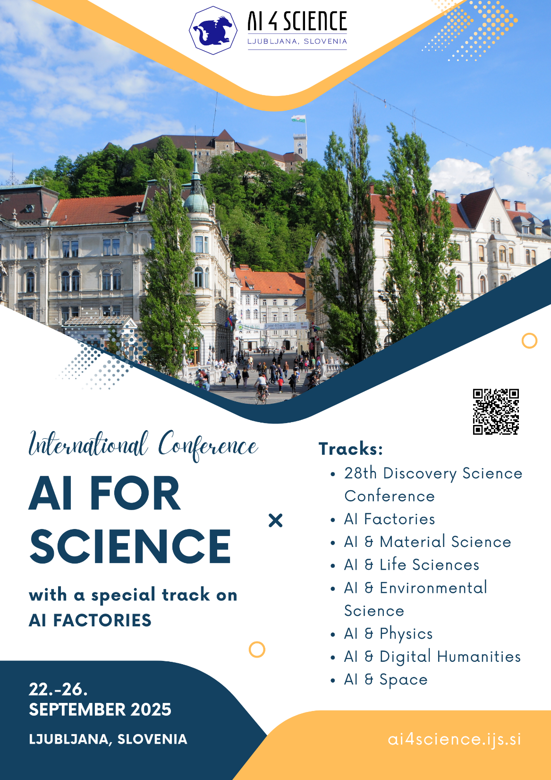
AI FOR SCIENCE
AI for Materials Science
Accelerating discovery of new materials, optimizing properties, and simulating complex molecular interactions
AI for Climate Science
Enhancing climate models, analyzing complex atmospheric data, and improving predictions for climate change impacts
AI for Fundamental Research
Supporting physics, chemistry, and astronomy with advanced pattern recognition and data analysis capabilities
Gravity ARIS projects on:
Artificial Intelligence for Science
Large Language Models for Digital Humanities

Slide 13
AI FOR SCIENCE
AI for Materials Science
Accelerating discovery of new materials, optimizing properties, and simulating complex molecular interactions
AI for Climate Science
Enhancing climate models, analyzing complex atmospheric data, and improving predictions for climate change impacts
AI for Fundamental Research
Supporting physics, chemistry, and astronomy with advanced pattern recognition and data analysis capabilities
Gravity ARIS projects on:
Artificial Intelligence for Science
Large Language Models for Digital Humanities

Slide 14
LLMs4EU & ERA Chair Projects
LLMs4EU – Large Language Models for the European Union
(ALT EDIC, in Slovenija JSI, Uni Lj and others)
WP2. Data Collection and Data Infrastructure
  T2.1 Identification and Specifications for Language Data (JSI lead)
WP3. Language Technology Tools catalogue
  T3.1 Definition of requirements for a large language and multimodal model catalogue (JSI lead)
WP4. Methodologies, algorithms and infrastructure for model fine-tuning
WP5. Distributed Evaluation Centre for LLMs
European Research Area Chair research groups:
AutoLearn-SI: Leveraging Benchmarking Data for Automated Machine Learning and Optimization: Automated Machine Learning (AutoML) and Automated Optimisation (AutoOPT) / Tome Eftimov, JSI
Artificial Intelligence 4 Digital Humanities: methods for collecting and analyzing large-scale textual data in various languages / Marko Robnik Sikonja Uni Lj,
Antoine Doucet, @ La Rochelle University, France

Slide 15

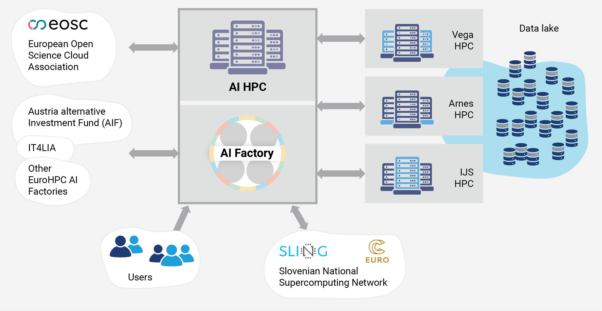

SLAIF: Supercomputer (temporary name AI-HPC)
SLING consortium is the main driving force behind the success of the Vega EuroHPC and SLAIF acceptance its latest achievement.

Slide 16
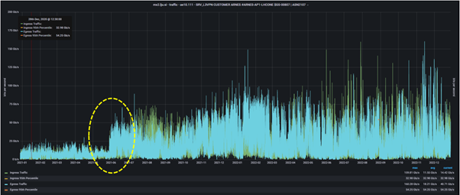



AI-HPC
Consortium: IZUM, IJS, Arnes
  Provides AI services and solutions
  EuroHPC Joint Undertaking – to boost small and medium enterprise growth
  Common development within SLAIF and SLING​ with NCC
Estimated specifications:
  Computing power : 100 PFLOPS FP64, 10 ExaFLOPS FP4/FP8
  Storage capacity: 100 PB
  Connectivity (ARNES/GÉANT): ~ 1.2 Tb/s​
  Peak power: 5-6 MW
  Integration with Open Data Infrastructure and other computing centres

Slide 17
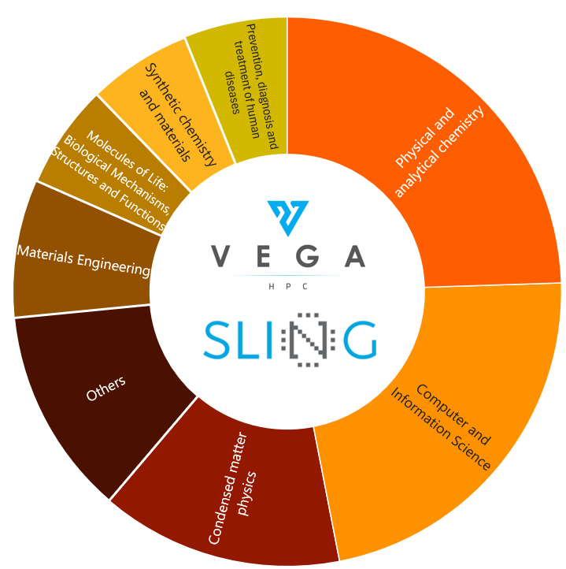
Requirements and Goals
Vega EOL in 2027, AI-HPC provides existing functionality:
  support applications using CPU
  (scientific) applications using GPU
  permanent data storage (international scientific collaboration)
  open data infrastructure
Most of funding for AI-optimised equipment
  Support double precision compute if possible
Efficient resource usage and simplicity of access
  Scheduling of tasks/jobs (SLURM) - fast and efficient execution
  Cloud infrastructure (OpenStack, K18s) ~ commercial clouds
  Efficient and fast user support, training, education and outreach
Integration with other centres:
  transparent data access to external data and transfers
  transparent usage of partner centres (IT4LIA HPC, AT HPC,...)
System, services, functionality and security
flexibility for users (DevOps)

Slide 18

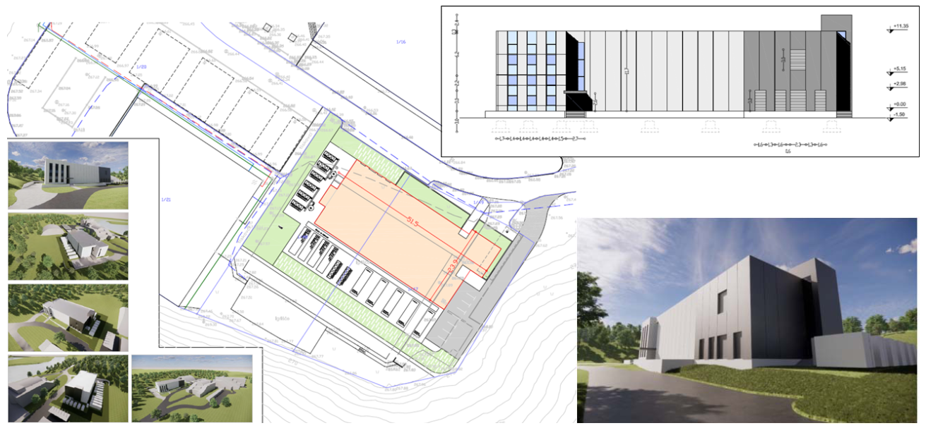
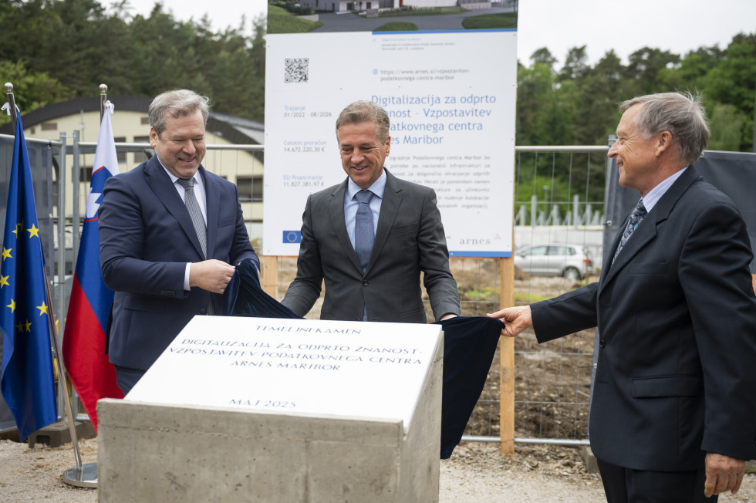
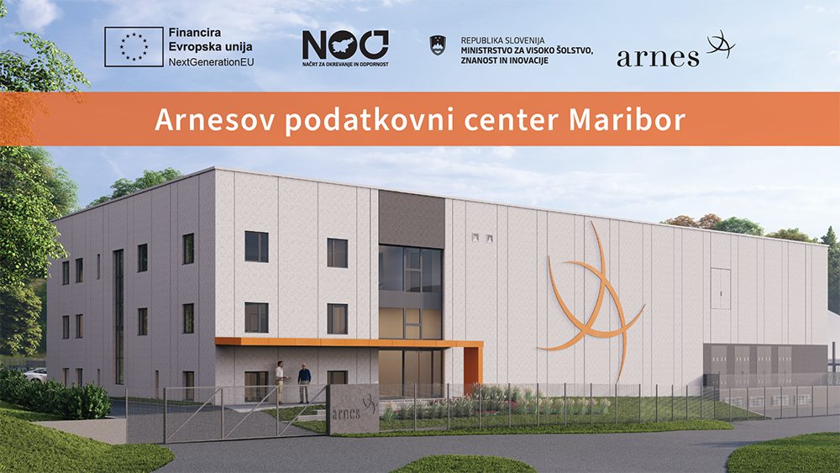
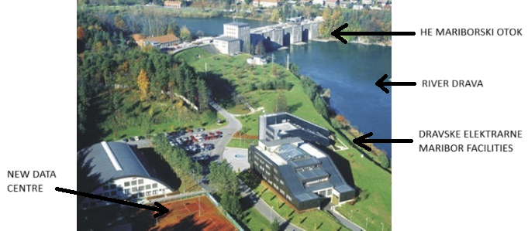
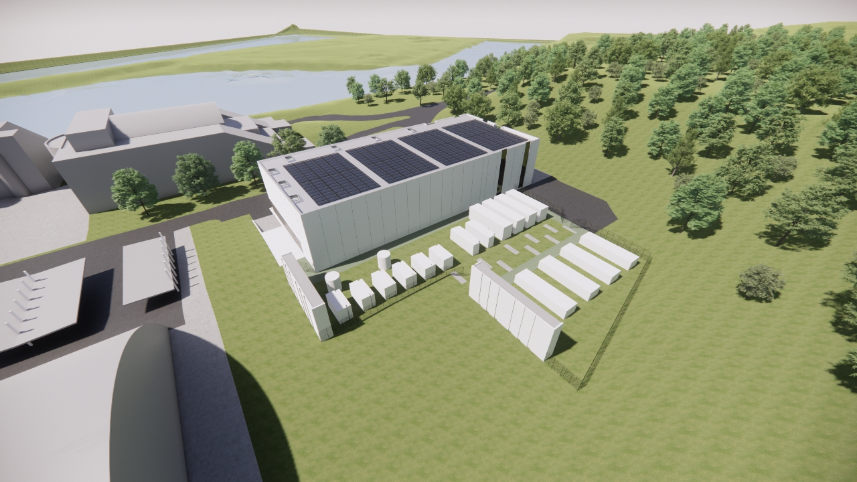
New Data Centre
Strategic position: power source, heat reuse, HE location
Construction
started
May 6th 2025

Slide 19
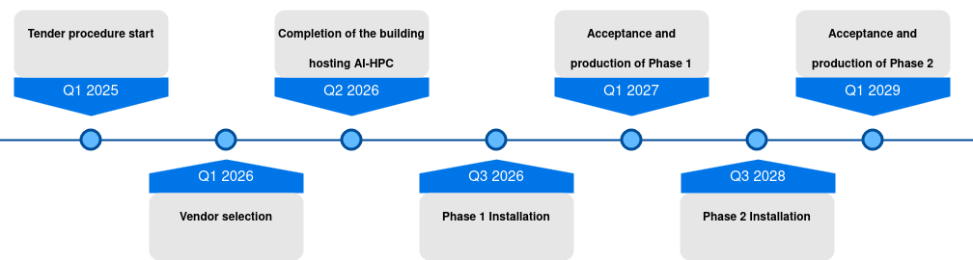
AI-HPC timeline
Phase 1: 7-year operation (2034) Phase 2: 5-year operation

Slide 20
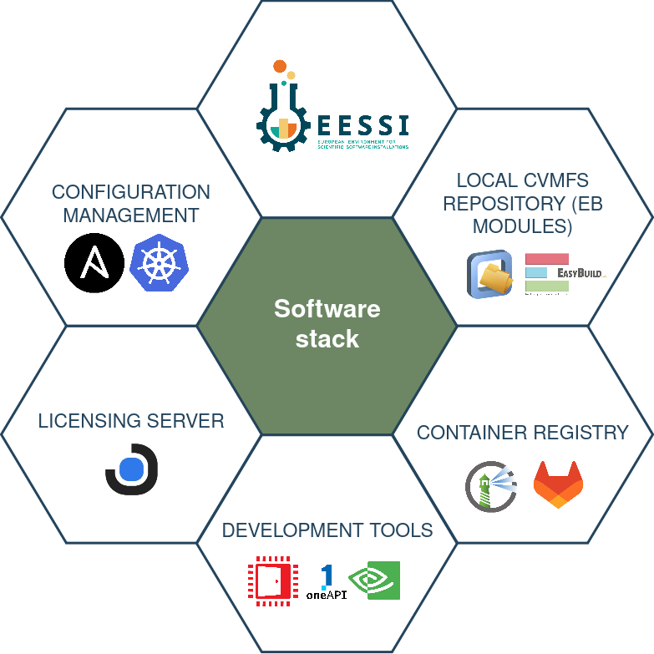
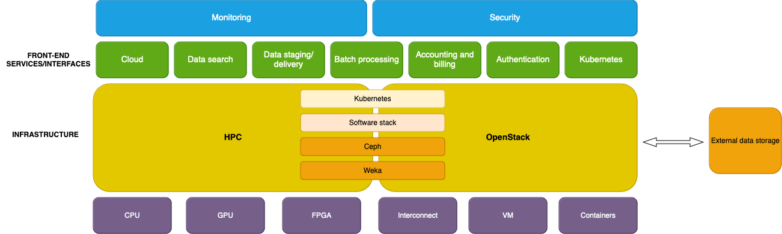
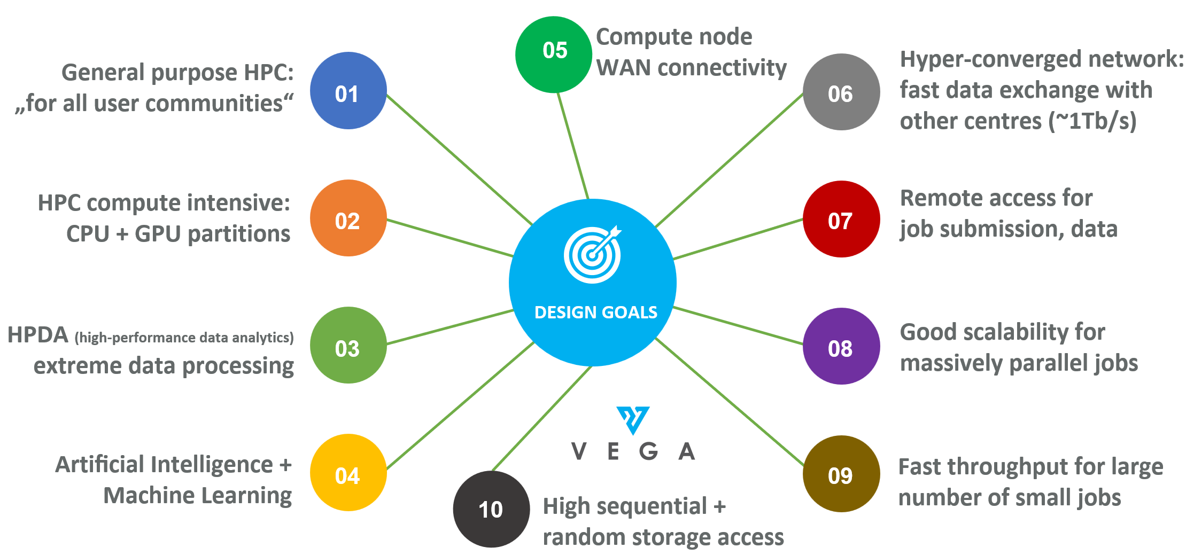
AI-HPC Hybrid Architecture
HPC/queue for efficiency
Cloud interfaces for interoperability
Automated configuration and provisioning
Support for workflow deployment
Scientific software and AI stack
(EESSI, CVMFS, registries and repositories)

Slide 21
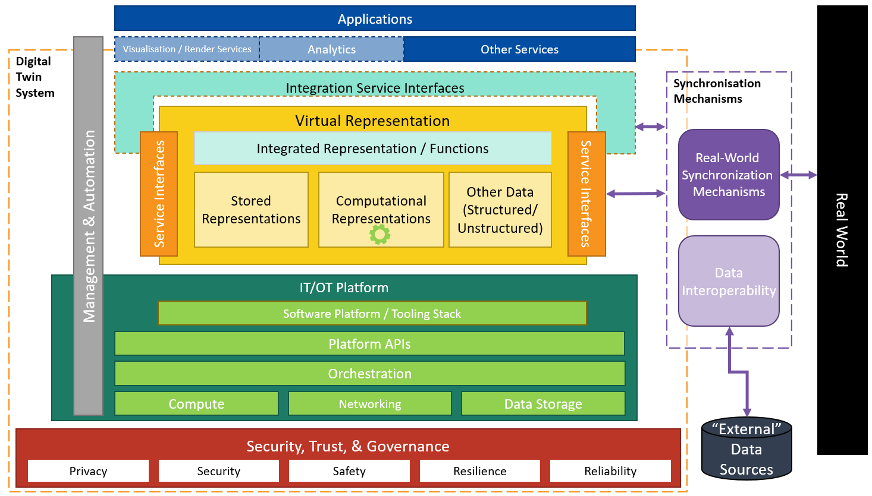
Flexibility of AI-HPC Infrastructure
Agile hybrid and modular architecture
  transparent resource allocation for computational tasks, interactive work, development and services
  system and environment
  configuration on user demand
Usage modes:
  classic HPC, containers, virtualisation
  user-driven service environment
Unified data access
  direct (posix)
  remote (https/davs, xrootd, S3 protocols ...)
  federated access to (AI) datasets,
  central catalogue
  transparent data sharing in federated data centres
Services for workflow and data orchestration
  Fully automated processing chains

Slide 22
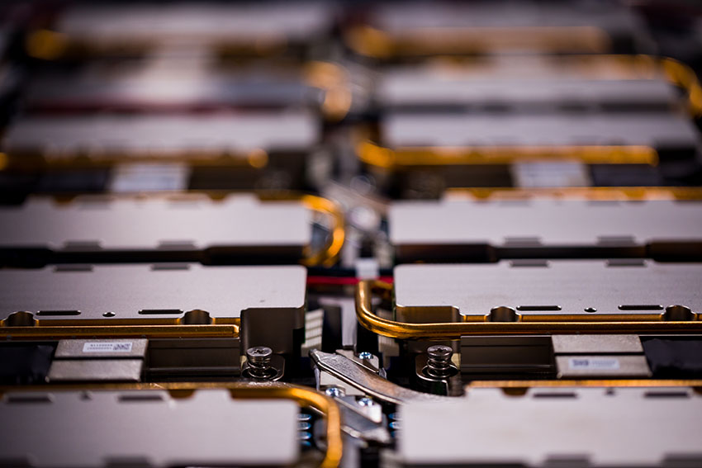
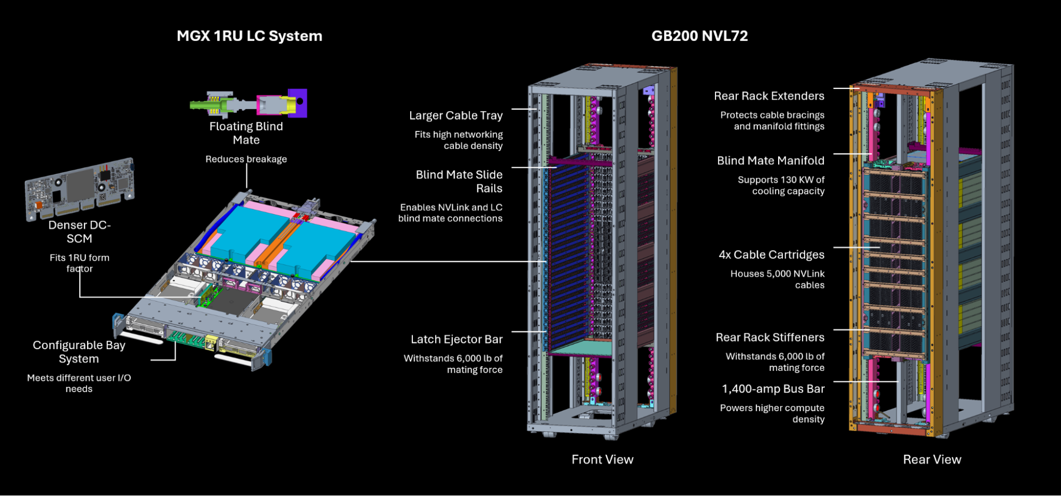
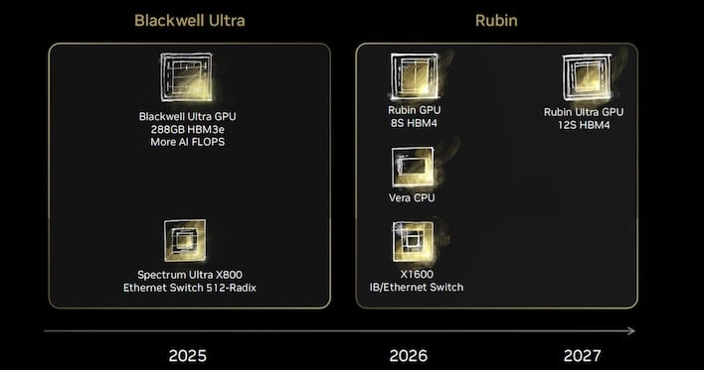
Hardware Options
CPU: 300-400k cores
  AMD (Venice)
  ARM64 (Grace, RHEA-2, Vera)
GPU: 2-3k cards
  NVidia GB200/300, Rubin
  AMD MI450x
Storage:
  High throughput: Weka, VAST, DDN Infinia...
  Large capacity: Ceph (FS, S3,...)
Interconnect:
  Infiniband, BX3, Slingshot - 800Gb/s, 1.6Gb/s
  NVLink6/7 - 4/8/72

Slide 23


Questions?
With thanks to,
among many:
Andrej Filipčič
Barbara Krašovec
Damjan Harisch
Dejan Lesjak
Dejan Valh
Dragi Kocev
Iztok Lebar Bajec
Panče Panov
Uroš Lotrič

Slide 24
Funding
 | Cost [MEUR]​
HPC (CAPEX + OPEX)​ | 123.3​
AI Factory | 11.7​
HPC + AI Factory | 135.0​
HPC (IT4LIA)​ | 10.0​
Total | 145.0​

